Slide 1

Superconducting Spiking Neural Networks: Design to Fabricate
Changxu Song
University of Southern California
December 13, 2024

Slide 2
Outline
Superconductor SNN Architecture
a. Literature review
b. High fanin LIF neural hardware design
Framework
a. Overall network design
b. Training
Layout Design
a. Hierarchical Design
b. Chip

Slide 3
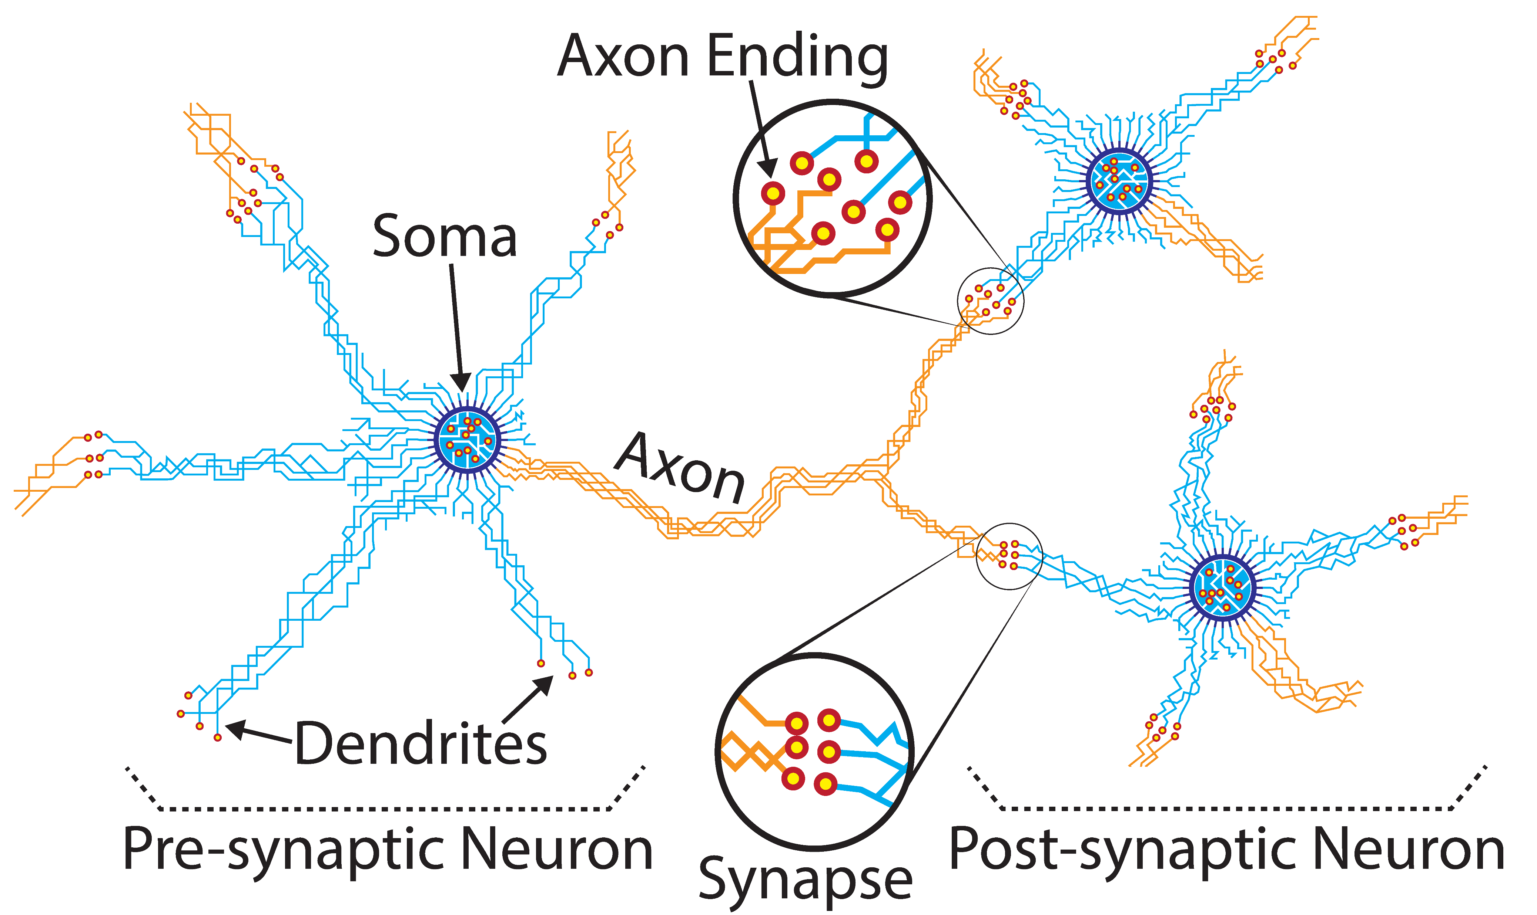
Biological Neural Network
Neuron: Fundamental units of nervous system and brain
Soma: Central cell body acts like a threshold function
Axon: Carries and sends the impulses from one to other neurons
Axon ending (Axon terminal): Forms junctions with other cells
Dendrite: Receives the signals from other cells
Synapse (Neuronal junction): The point of contact between neurons
Bozbey A, Karamuftuoglu M A, Razmkhah S and Ozbayoglu M 2018 Single flux quantum based ultrahigh speed spiking neuromorphic processor architecture (arXiv:1812.10354)

Slide 4
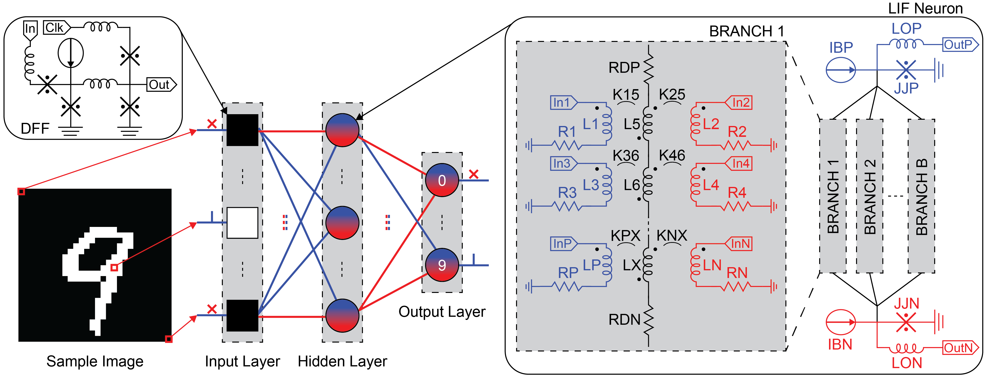

Superconductor SNN Architecture
Sample Image: Pixels are set to 1 or 0 depending on the threshold
Input layer: Consist of DFFs to load vector
Neuron layer: Consist of LIF neurons
LIF Neuron: Generate pulse based on the input value, threshold, Membrane Potential
SNN trained with backpropagation
Membrane Potential
Reset function
$$\text{U}\text{(}\text{t}\text{)}=βU\left(t−1\right)+I\left(t\right)+f_{reset}(t)$$
Decay rate
Goal: Implementing the Inference model with extremely limiting resources on the chip
*Karamuftuoglu, Mustafa Altay, et al. "Scalable superconductor neuron with ternary synaptic connections for ultra-fast SNN hardware." arXiv preprint arXiv:2402.16384 (2024).​

Slide 5
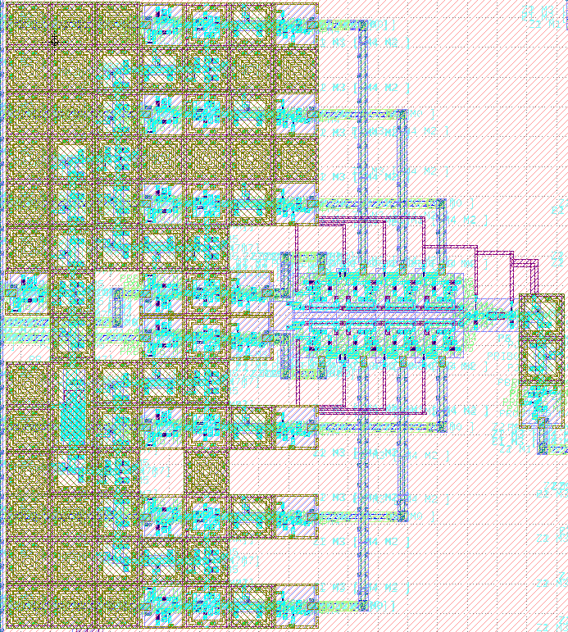
High Fan-in Neuron (Hardware Design)
PTL* : PTL transmitter, PTL, PTL receiver
I
JJ
JTL
PTLTx
Out+
In1(0)
DFF
JTL
PTL*
K1
L
L
Branch2
R
+
In2+
DFF
JTL
PTL*
K2
L
L
R
-
In3+
DFF
JTL
PTL*
K3
L
L
R
Same neuron for Hidden layer and Output Layer
Delete the negative output because of area limitation
A combination of +6 and -2 is best for accuracy
Add DFFs for sync instead of manually adding delay among path
Add JTL to increase the latency of the positive path
In4-
DFF
PTL*
K3
Branch1
L
L
R
R
Synapse with Ternary weight (-1,0,1)

Slide 6
Framework
Hardware cons & pros
Pros:
Only need to classify 2,3,4
Cons:
1. The sparsity of the first weight matrix should be higher than 90%, and 70% for the second weight matrix
2. Each neuron has a maximum fan-in of 8 connections, and all neurons must have identical structure to alleviate hardware demands
3. Input should be downsampled from 28x28 to 7x7 image
4. label collapse (a result of overfitting to specific patterns or features present in the training data)
Content
1. Overall Network Design
2. Training:
a. SNNtorch
Leaky Integrate-and-Fire Neuron
b. Pre-data processing with down-sampling
c. Backpropagation with a combined loss
d. Normalization of Weight based on ternary quantization
e. Layer-wise ternary quantization and pruning

Slide 7
Framework
Overall Network Design
Training
Dataset：MNIST (Whole data for digits 2,3,4)
Tool: Downsampling image with OpenCV; Training the SNN with SNNtorch
Main Parameter:
num_inputs_neuron = 49, num_hidden_neuron = 24, num_outputs = 3, decay_values= [0,0,0], thresholds = [1, 2, 2], Max_fanin = 8, Ternary Quantization = [-1,0,1]
Training
Training
Training
Downsampling
Pruning
Quantization
Final Weight
Training Suqence
Leaky Layer 0
QuantLayer 0
(quantized weight)
Leaky Layer 1
QuantLayer 1
(quantized weight)
Leaky Layer 2
Network Structure
Inference
Using the final Ternary Neural Network model to do the inference
Generate neuron connections between layers for the hardware design
Report the correct cases for hardware simulation

Slide 8
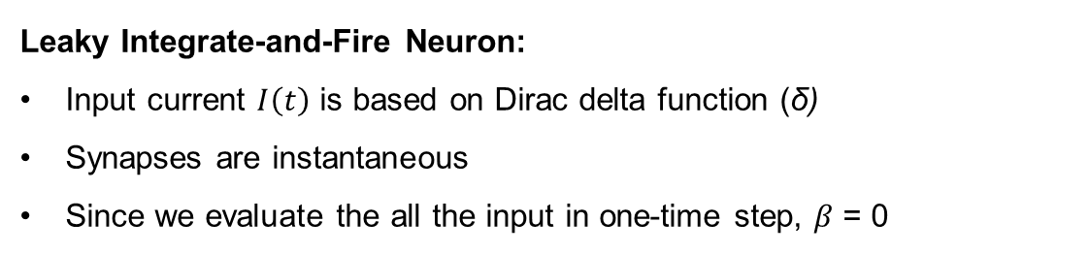
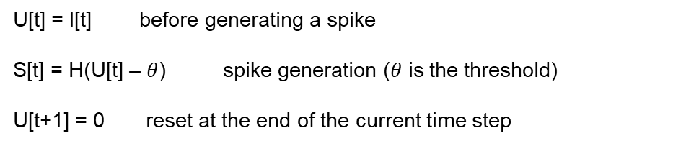




Training
Leaky Integrate-and-Fire Neuron:
Input current $I\left(t\right)$ is based on Dirac delta function (δ)
Synapses are instantaneous
Since we evaluate the all the input in one-time step, $β$ = 0
decay rate
input
$$\text{U}\text{(}\text{t}\text{)}=βU\left(t−1\right)+I\left(t\right)+f_{reset}(t)$$
W
Membrane Potential
Reset function
$$S\left(t\right)$$
Original Equation
$$I\left(t\right)$$
$$U\left(t\right)$$
U[t] = I[t] before generating a spike
S[t] = H(U[t] – $θ$) spike generation ($θ$ is the threshold)
U[t+1] = 0 reset at the end of the current time step
All the positive or the negative inputs come at the same time
H: Heaviside function
H(x) = { 1, if x ≥ 0
0, if x < 0 }
Our Model Equation

Slide 9
Training
Leaky Layer:
Consist of Leaky Integrate-and-Fire Neurons
Forward both mem and spikes for loss function ( mem is equal to U(t))
Reset the hidden state to zero of the neuron after every batch
Quant Layer:
Implementing layer-wise quantization after a certain epoch
Implementing mask for layer-wise pruning after a certain epoch
Quant Layer 0
Leaky Layer 0
...

Slide 10
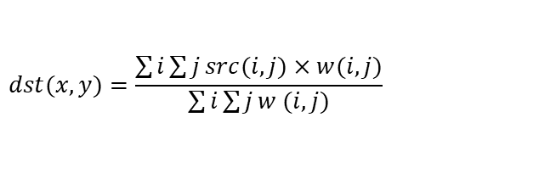
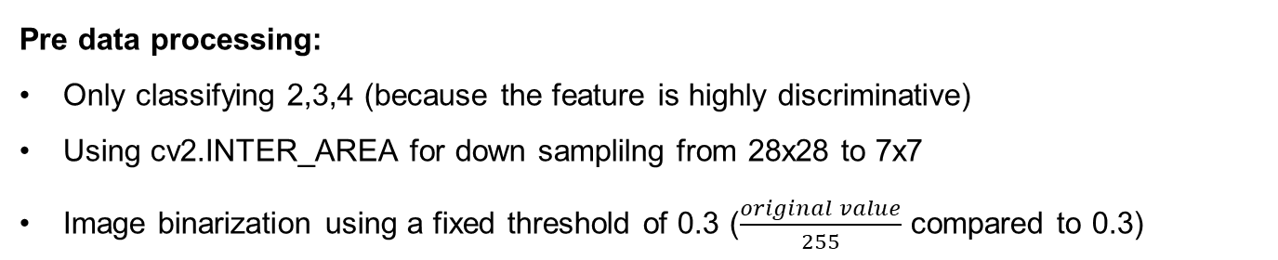
Training
Pre data processing:
Only classifying 2,3,4 (because the feature is highly discriminative)
Using cv2.INTER_AREA for down samplilng from 28x28 to 7x7
Image binarization using a fixed threshold of 0.3 ($\frac{original value}{255}$ compared to 0.3)
scale = target_size/source_size = 7/28
pixel_size = 1/scale = 4
target_start_x = x * pixel_size
target_end_x = (x + 1) * pixel_size
overlap_x = max(0, min(target_end_x, i + 1) - max(target_start_x, i))
overlap_y = max(0, min(target_end_y, j + 1) - max(target_start_y, j))
w(i,j) = overlap_x * overlap_y
Interpolation Method | Best Use Case | Speed | Quality
cv2.INTER_AREA | Image down sampling, anti-aliasing | Medium | Best for downscaling
cv2.INTER_LINEAR | General resizing | Fast | Regular
cv2.INTER_CUBIC | Image up sampling, smooth edges | Slow | Best for upscaling
INTER_AREA
$$dst(x,y)=\frac{\sum{i\sum{j}src(i,j)×w(i,j)}}{\sum{i\sum{j}w (i,j)}}$$
$$w\left(i,j\right)=overlap_area(source_pixel(i,j),target_pixel_area)$$
dst(x,y): pixel value at position (x,y) in the destination image
src(i,j): pixel value at position (i,j) in the source image's corresponding region
w(i,j): weight coefficient, determined by pixel overlap area
overlap_area: calculates the overlapping area between source pixel and target pixel region

Slide 11



Training
Down sampling examples with INTER_AREA

Slide 12
Training
Back Propagation with Combined Loss:
Loss value includes 0.6 * spike loss (L_spike), 0.4 * mem loss (L_mem), and 0.01 * regularization of weight based on fanin (L_constraint)
Use AdamW as the Optimized function
Samples are processed in batches, and weights are updated after each batch

Slide 13

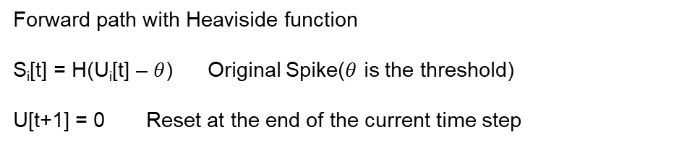

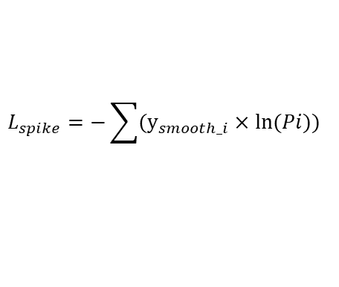










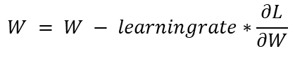
Training
0.6 * Spike Loss: Calculate cross-entropy loss with label smoothing using fast sigmoid as surrogate gradient (label smoothing is used for fixing the overfitting problem)
Forward path with Heaviside function
S_{i}[t] = H(U_{i}[t] – $θ$) Original Spike($θ$ is the threshold)
U[t+1] = 0 Reset at the end of the current time step
Fast sigmoid for backward pass, the actual pulse is non-derivable
An example of updating the weight matrix close to the output layer
$$S_{i}≈\frac{U_{i}}{1+k|U_{i}|}$$
k is a hyperparameter which is defaults to 20
$$\frac{∂L_{spike}}{∂S_{i}}=S_{i}−y_{smooth_i}$$
Fast sigmoid
$$\frac{∂S_{i}}{∂U_{i}}=\frac{1}{(1+k{|U_{i}|)}^{2}}$$
($\frac{∂S_{i}}{∂U_{i}}∈ [−0.05, 0.05]$)
$$\frac{∂S_{i}}{∂U_{i}}=\frac{1}{{\left(1 + 20\left|U_{i}− θ\right|\right)}^{2}}$$
Fast sigmoid
CrossEntropyLoss(label_smoothing=0.05)(spikes, targets)
$$\frac{∂U_{i}}{∂W_{ij}}=S_{j_{_previous_layer}}$$
Original Spike
$ε$= 0.05
$M$= 3
M is the output dimension
$$y_{smooth}=\left(1−ε\right)y+\frac{ε}{M} ∗[1,1,1]$$
Label Smoothing
$$\frac{∂L_{spike}}{∂W_{ij}}=\frac{∂L_{spike}}{∂S_{i}} ×\frac{∂S_{i}}{∂U_{i}}×\frac{∂U_{i}}{∂W_{ij}}$$
$$Pi=softmax\left(Li\right)$$
$$Mean$$
$$L_{spike}=−\sum{(y_{smooth_i}}×\ln{(Pi))}$$
Loss for the Original Spike
$$W = W − learningrate∗\frac{∂L}{∂W}$$

Slide 14

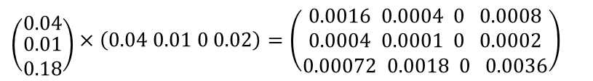










Training
Parallel Computation of Spike Loss with GPU:
B= 1
N= 4
M: 3
$$\frac{∂L}{∂S} ℝ^\{B×M\}$$
Example:
$$\frac{∂L}{∂S}= \left[0.1, 0.2, 0.3\right]$$
$$\frac{∂S}{∂U} ℝ^\{B×M\}]$$
$$\frac{∂S_{i}}{∂U_{i}}=\frac{1}{(1+k{|U_{i}|)}^{2}}$$
$$\frac{∂S}{∂U}= \left[0.4, 0.5, 0.6\right]$$
$${\frac{∂U}{∂W_{ij}}=S}_{previous_neuron}$$
$$\frac{∂S}{∂U}×\frac{∂L}{∂S}= \left[0.04, 0.1, 0.18\right]$$
$$ℝ^\{B×M\}$$
$$\frac{∂L}{∂W}=\frac{∂L}{∂S} ×\frac{∂S}{∂U}×S_{previous_neuron}$$
$$S_{previou_neuron=[0.04, 0.01, 0, 0.02]}$$
($\left[B,M\right]\text{⊙}\left[B,M\right])T×\left[B,N\right]=[M,N]$
Outer Product:
B: Batch size
N: Input dimension
M: Output dimension
$$\left({0.04 \atop \begin{aligned}0.01 \\ 0.18\end{aligned}}\right)×\left(0.04 0.01 0 0.02\right)=\left(\begin{aligned}0.0016 0.0004 0 0.0008 \\ 0.0004 0.0001 0 0.0002 \\ 0.00072 0.0018 0 0.0036\end{aligned}\right)$$

Slide 15



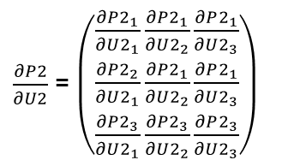







Training
0.4 * Mem Loss ( which is another way to say U(t) loss):
Why: Solving the overfitting problem because of just using spike loss
How: Save the mem of every neuron in every layer at the end of the current time step for mem loss computation ( function provided by SNNtorch)
An example of updating the weight matrix close to the output layer (B=1)
$$\frac{∂L_{mem2}}{∂P2}=−\frac{y_{i}}{P2}$$
Since we use softmax for U2
$$Leaky2 U2∈ ℝ^\{B×3\}$$
$$\frac{∂P2}{∂U2}=P×(I−P2)$$
$$\frac{∂P2_{i}}{∂U2_{j}}= P2_{i}× \left(δij − P2_{j}\right)$$
$$U2=W2×S1$$
$\frac{∂P2}{∂U2}$ = $\left(\begin{aligned}\frac{∂P2_{1}}{∂U2_{1}}\frac{∂P2_{1}}{∂U2_{2}}\frac{∂P2_{1}}{∂U2_{3}} \\ \frac{∂P2_{2}}{∂U2_{1}}\frac{∂P2_{1}}{∂U2_{2}}\frac{∂P2_{1}}{∂U2_{3}} \\ \frac{∂P2_{3}}{∂U2_{1}}\frac{∂P2_{3}}{∂U2_{2}}\frac{∂P2_{3}}{∂U2_{3}}\end{aligned}\right)$
$$\frac{∂L_{mem2}}{∂U2}=\frac{∂L_{mem2}}{∂P2}×\frac{∂P2}{∂U2}$$
$P2=softmax\left(U2\right) P2 ∈ℝ^\{B×3$}
$$\frac{∂U_{i}}{∂W_{ij}}=S_{j_{_previous_layer}}$$
$$L_{mem2}=−\sum_{i=1}^{M}{{(y}_{i }×\ln{P2)}}$$
$$\frac{∂L_{mem2}}{∂W}=\frac{∂L_{mem2}}{∂U2}×\frac{∂U2}{∂W2}$$

Slide 16
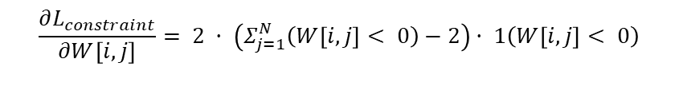

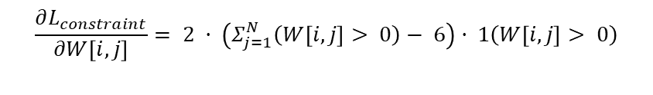

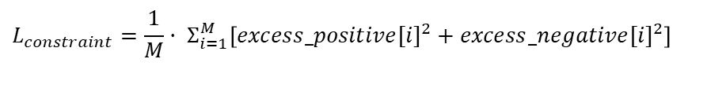
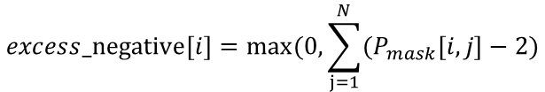
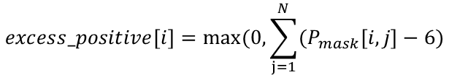
Training
0.4 * Constraint Loss:
Why: Push the fanin toward at most +6 and -2 input structure ( More than 90% of fanin for neurons is consist of at most +6 and -2 before setting that constraint)
How: Combine the hard constraint and soft constraint. Hard constraints only allow the network to generate the ideal weight. Soft constraints make the network generate the ideal weight.
Max_positive_weight = 6
If $Σ_{j=1}^{N}\left(W\left[i,j\right]> 0\right)>6$
Max_negative_weight = 2
$$\frac{∂L_{constraint}}{∂W\left[i,j\right]}= 2 · \left(Σ_{j=1}^{N}\left(W\left[i,j\right]> 0\right)− 6\right)· 1\left(W\left[i,j\right]> 0\right)$$
$$P_mask[i,j] = 1 if W[i,j] > 0 else 0$$
$$N_mask[i,j] = 1 if W[i,j] < 0 else 0$$
If $Σ_{j=1}^{N}\left(W\left[i,j\right]<0\right)>2$
$$excess_positive[i]=max⁡(0,\sum_{j=1}^{N}{(P_{mask}\left[i,j\right]−6)}$$
$$\frac{∂L_{constraint}}{∂W\left[i,j\right]}= 2 · \left(Σ_{j=1}^{N}\left(W\left[i,j\right]< 0\right)−2\right)· 1\left(W\left[i,j\right]< 0\right)$$
$$excess_negative[i]=max⁡(0,\sum_{j=1}^{N}{(P_{mask}\left[i,j\right]−2)}$$
2 is just a hyperparameter: scaling factor
$$L_{constraint}=\frac{1}{M}· Σ_{i=1}^{M}\left[{excess_positive[i]}^{2}+{excess_negative[i]}^{2}\right]$$
M is the output dimension

Slide 17



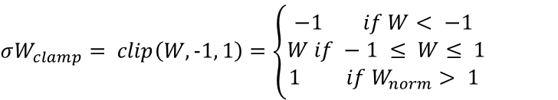
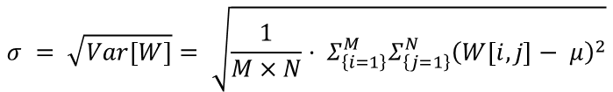
Training
0.01 * Weight Normalization:
Why: Push the weight toward +1,0 and -1 to minimize the information loss after weight quantization
How: Begin normalizing the weight 1 epoch before the quantization starts. Clamping the weight in [-1,1].
$$W_{norm}=\frac{W − μ}{σ + ε}$$
$ε$= 1e-8
$$μ = E\left[W\right]=\frac{1}{M×N}· Σ_{\left\{i=1\right\}}^{M}Σ_{\left\{j=1\right\}}^{N}W\left[i,j\right]$$
$$σ = \sqrt{Var\left[W\right]}= \sqrt{\frac{1}{M×N}· Σ_{\left\{i=1\right\}}^{M}Σ_{\left\{j=1\right\}}^{N}{\left(W\left[i,j\right]− μ\right)}^{2}}$$
$$σW_{clamp}= clip\left(W, −1, 1\right)=\left\{\begin{aligned}−1 if W< −1 \\ &W if −1 ≤ W≤ 1 \\ 1 if W_{norm}> 1 \end{aligned}\right.$$

Slide 18



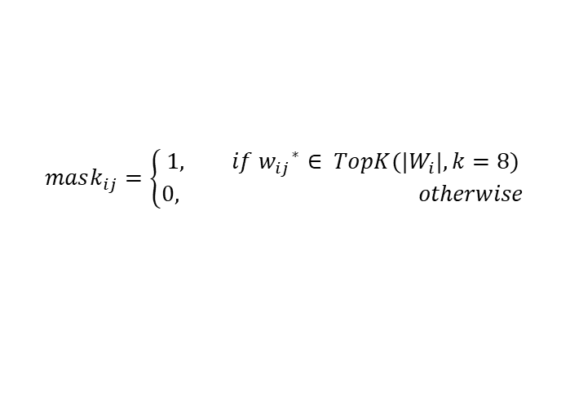
Training
Layer Wise Pruning
Why: Avoids simultaneous network perturbation. The first layer stabilizes basic feature extraction paths and then make second layer optimized decision-making based on stable features
How: training → pruning the Quant Layer 1 → training → pruning the Quant Layer 2 → training
$${w_{ij}}^{∗}= \left|w_{ij}\right|$$
$$M_{i}=Top_{k}({w_{ij}}^{∗},k=8)$$
$$mask_{ij}=\left\{\begin{aligned}1, if {w_{ij}}^{∗}∈ TopK(|W_{i}|, k=8) \\ 0, otherwise\end{aligned}\right.$$
$$w_{pruned}=W⊙mask$$

Slide 19


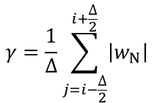


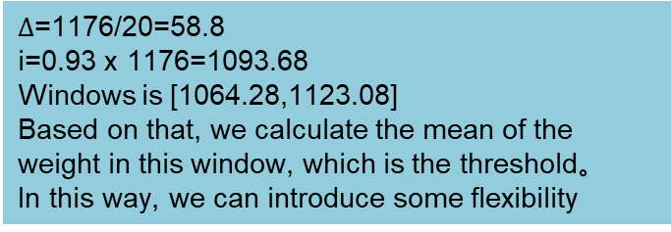



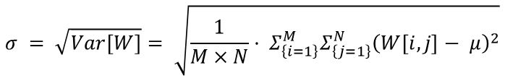
Training
Layer Wise Quantization
Why: Avoids simultaneous network perturbation
How: training → pruning the Quant Layer 2 → training → pruning the Quant Layer 1 → training
For Quant Layer 1, using adaptive method
For Quant Layer 2, using Statistical threshold based on weight distribution
Input Layer 49
Hidden Layer 24
Based on that: Fully connection 1176 weights, we want to prune around 93%.
Say our chip height is 3900u. Each cell height is 30u. 3900/30=130 rows of cells at most.
(1176-130)/1176=89%
The pruning amount needs to be greater than 89%
$$\left|w_{1}\right|≤\left|w_{2}\right|≤\left|w_{3}\right|≤…≤\left|w_{N}\right|$$
Sorting the weights
N is the number of the total weights
i is the total number of weight we need to prune
$$μ = E\left[W\right]=\frac{1}{M×N}· Σ_{\left\{i=1\right\}}^{M}Σ_{\left\{j=1\right\}}^{N}W\left[i,j\right]$$
$$i=0.93N$$
$$∆=\frac{N}{20}$$
Window Size 20 (Which is a hyperparameter and could be changed )
$$σ = \sqrt{Var\left[W\right]}= \sqrt{\frac{1}{M×N}· Σ_{\left\{i=1\right\}}^{M}Σ_{\left\{j=1\right\}}^{N}{\left(W\left[i,j\right]− μ\right)}^{2}}$$
$$window \left[i−\frac{∆}{2}, i+\frac{∆}{2}\right]$$
$$γ=α⋅μ+β⋅σ$$
$∆$=1176/20=58.8
i=0.93 x 1176=1093.68
Windows is [1064.28,1123.08]
Based on that, we calculate the mean of the weight in this window, which is the threshold。
In this way, we can introduce some flexibility
$$γ=\frac{1}{∆}\sum_{j=i−\frac{∆}{2}}^{i+\frac{∆}{2}}{\left|w_{N}\right|}$$
$$W_{ij}^{q}=Q\left(W_{ij};γ\right)=\left\{\begin{aligned}1, ifW_{ij}>γ \\ 0, if−γ≤W_{ij}≤γ \\ −1, ifW_{ij}<γ\end{aligned}\right.$$
Mean: will be used as threshold

Slide 20
Framework
Best Model Weights (Accuracy: 80.75%):
==================================================
Layer 0 Weights Matrix (24x49):
==================================================
0 0 0 1 0 0 0 0 0 0 0 0 0 0 0 0 0 0 0 0 0 0 0 0 0 0 0 0 0 0 1 1 0 0 0 0 0 0 0 0 1 0 0 0 0 0 0 0 0
0 0 1 1 1 0 0 0 0 0 1 0 0 0 0 0 0 0 0 0 0 0 0 0 0 0 0 0 0 1 0 0 0 0 0 0 0 1 0 0 0 0 0 0 0 0 0 0 0
0 0 0 0 -1 0 0 0 0 0 0 0 0 0 0 0 0 0 0 0 0 0 1 0 0 0 0 0 1 0 0 0 0 0 -1 0 0 0 0 0 0 0 0 0 0 0 0 0 0
0 0 -1 0 0 0 0 0 0 0 0 0 0 0 0 0 0 0 0 0 0 0 0 1 1 0 0 0 0 0 0 0 1 0 0 0 0 0 0 0 0 0 0 0 0 0 0 0 0
0 0 0 0 0 0 0 0 0 0 0 0 0 0 0 0 0 0 0 0 0 0 0 0 0 0 0 0 0 0 0 0 0 0 0 0 0 0 0 0 0 0 0 0 0 0 0 0 0
0 0 0 -1 0 0 0 0 0 0 1 0 0 0 0 0 0 0 0 0 0 0 0 0 0 0 0 0 0 0 -1 0 0 1 0 0 1 0 1 0 0 0 0 0 1 0 0 0 0
0 0 0 0 0 0 0 0 0 0 0 0 0 0 0 0 0 0 0 0 0 0 0 0 0 0 0 0 0 0 0 0 0 0 0 0 0 0 0 0 0 0 0 0 0 0 0 0 0
0 0 -1 0 0 0 0 0 0 0 0 0 0 0 0 0 0 0 0 0 1 1 0 1 0 0 1 0 0 0 0 1 0 0 0 0 0 0 0 0 0 0 0 0 0 0 0 0 0
0 0 0 0 0 0 0 0 0 0 0 0 0 0 0 0 0 0 0 0 0 0 0 0 0 0 0 0 0 0 0 0 0 0 0 0 0 0 0 0 0 0 0 0 0 0 0 0 0
0 0 0 0 0 0 0 0 0 0 0 0 0 0 0 0 0 0 0 0 0 0 1 0 0 0 0 0 0 0 1 1 0 0 0 0 0 0 0 0 0 0 0 -1 -1 0 0 0 0
0 0 0 0 1 0 0 0 0 0 1 1 0 0 0 0 0 0 0 0 -1 0 0 0 0 0 0 1 0 0 0 1 0 0 1 0 0 0 0 0 0 0 0 0 0 0 0 0 0
0 0 -1 0 0 0 0 0 1 0 0 0 0 0 0 0 0 0 0 0 0 0 0 0 0 0 0 0 1 0 0 0 0 0 0 0 0 0 0 1 0 0 0 1 1 1 0 0 0
0 0 0 0 0 0 0 0 0 0 0 0 0 0 0 0 0 0 0 0 0 0 0 0 0 0 0 0 0 0 0 0 0 0 0 0 0 0 0 0 0 0 0 0 0 0 0 0 0
0 0 0 -1 -1 0 0 0 0 0 0 0 1 0 0 0 0 0 0 0 0 0 1 1 0 1 0 0 0 0 0 0 0 0 0 0 0 0 0 0 0 0 0 0 0 0 0 0 0
0 0 0 0 0 0 0 0 0 0 0 0 0 0 0 0 0 1 0 0 0 0 0 0 0 0 0 0 0 0 0 -1 0 0 0 1 0 0 0 1 0 0 0 0 0 0 0 0 0
0 0 0 0 0 0 0 0 0 0 0 0 0 0 0 0 0 0 0 0 0 0 0 0 0 0 0 0 0 0 0 0 0 0 0 0 0 0 0 0 0 0 0 0 0 0 0 0 0
0 0 0 1 0 0 0 0 0 0 1 0 0 0 0 0 0 0 0 0 0 0 0 0 0 0 0 0 0 0 0 1 0 0 1 0 0 0 0 0 0 0 0 0 0 0 0 0 0
0 0 0 -1 -1 0 0 0 0 0 0 0 0 0 0 0 1 0 0 0 0 0 0 0 0 1 0 0 0 0 0 0 0 0 0 0 0 0 0 0 0 0 0 0 0 0 0 0 0
0 0 0 -1 0 0 0 0 0 0 0 0 0 0 0 0 0 0 0 0 0 0 1 1 0 0 0 0 0 0 0 1 0 0 0 -1 0 0 0 0 0 0 0 0 0 0 0 0 0
0 0 0 0 0 0 0 0 0 0 0 0 0 1 0 0 1 0 0 0 1 0 1 1 0 0 0 0 0 0 0 0 0 0 0 0 -1 0 0 0 0 0 0 0 0 0 0 0 0
0 0 1 1 1 0 0 0 0 0 0 0 0 0 0 0 0 0 0 0 0 0 -1 0 0 0 0 0 0 0 1 0 0 0 1 0 1 0 0 0 0 0 0 0 0 0 0 0 0
0 0 0 0 0 0 0 0 0 0 0 0 0 0 0 0 0 0 0 0 0 0 0 0 0 0 0 0 0 0 0 0 0 0 0 0 0 0 0 0 0 0 0 0 0 0 0 0 0
0 0 0 0 0 0 0 0 0 0 0 0 0 0 0 0 0 0 0 0 0 0 0 0 0 0 0 0 0 1 0 1 0 1 0 0 0 0 0 0 1 1 0 0 0 0 0 0 0
0 0 0 -1 0 0 0 0 0 0 1 0 0 0 0 0 0 1 0 0 0 0 0 0 1 0 0 0 0 0 0 -1 0 0 0 0 1 0 0 0 0 0 0 0 0 0 0 0 0
Matrix Statistics:
Total elements: 1176
Number of 1s: 76 (6.46%)
Number of -1s: 21 (1.79%)
Number of 0s: 1079 (91.75%)
In the down sampling MNIST dataset, the boundary pixels are often uninformative
Unused pixels: [1, 2, 6, 7, 8, 10, 15, 16, 19, 20, 43, 47, 48, 49]

Slide 21
Framework
Layer 2 Weights Matrix (3x24):
==================================================
1 1 -1 -1 0 0 0 0 0 0 1 0 0 0 0 0 1 0 0 0 1 0 1 0
-1 1 0 1 0 1 0 0 0 -1 0 1 0 0 1 0 0 0 0 0 0 0 0 1
0 -1 1 0 0 0 0 1 0 0 0 0 0 1 0 0 0 1 1 1 0 0 0 0
Matrix Statistics:
Total elements: 72
Number of 1s: 18 (25.00%)
Number of -1s: 5 (6.94%)
Number of 0s: 49 (68.06%)
Leaky Layer 1 Dead neurons: [5, 7, 9, 13, 16, 22]

Slide 22
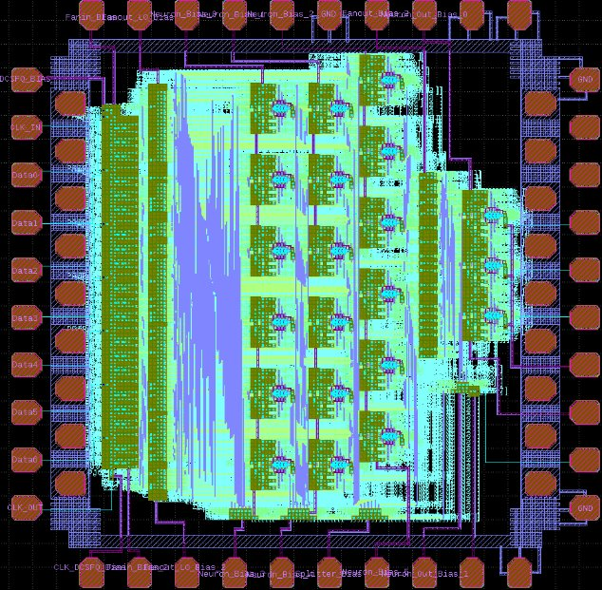
Hierarchical Design
Hardware Constrain:
Small Chip size: The chip size is 3400nm × 3900nm (after removing top and bottom GND pads). After considering the remaining routing space and pads, it can only accommodate below 25 neurons
Limited number of I/O pins: Total 40(input, output, bias, ground)
Custom Routing: Both time and manpower consuming, overly complex structures would significantly increase the difficulty
Final Hardware Hierarchical Design
Parameter (Chip) | Value
Input pins | 7
Output pins | 3
Layers | 3
Neuron | 18+3
Max_Fanout_Layer0 | 9
Max_Fanout_Layer1 | 3

Slide 23
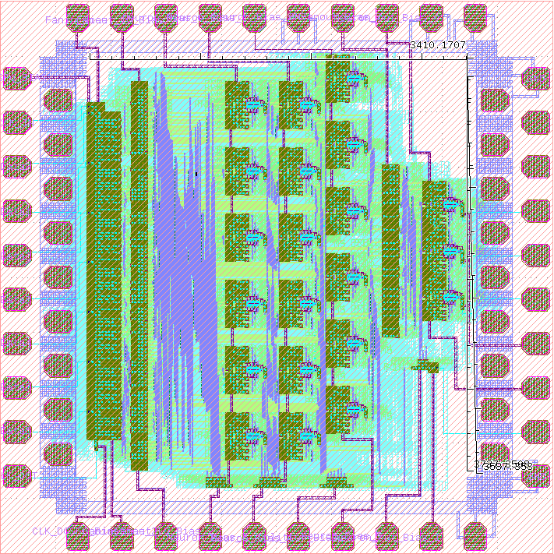
Chip
Leaky Layer 1
Fanout
Input Layer
IN1
SR1
Fanout
Neuron with Fanin
IN2
SR2
IN3
SR3
IN4
SR4
IN5
SR5
Leaky Layer 2
IN6
SR6
IN7
SR7

Slide 24
Input layer (Hardware Design)
In1 is sent to DFF1
CLK1 first tick, In1 will be sent to NDRO1 and will be dropped due to reset signal, and it will be saved in DFF2

Slide 25
Neural (Original Design)
Soma
I
Axon
R
JJ
JTL
Out+
In1(0)
JTL
K1
K4
JTL
In4-
L
L
L
High fan-in design with inhibitory effect
Simulated with JSIM
6 input neuron will be designed for the next tapeout
+
R
R
In2+
JTL
K2
K5
JTL
In5-
L
L
L
R
R
-
M. A. Karamuftuoglu, B. Z. Ucpinar, S. Razmkhah, and M. Pedram, "High Fan-in SFQ-Based Differential Spiking Neuron", Article in preparation.
In3+
JTL
K3
K6
JTL
In6-
L
L
L
R
R
I
Axon Ending
JTL
Out-
R
JJ
Synapse with Ternary weight (-1,0,1)

